Slide 1


Retail
Giant – Incremental Revenue Estimation
Challenges
Solutions
The client did not have access to a single point of view that measured the marketing effectiveness of various media sources to drive App downloads.
The marketing team required forecasted incremental revenues through App downloads in the short-term and long-term horizons to inform annual budgets
Conduct a comprehensive analysis to measure the long-term incremental effect on sales revenue after installing the App
Identify target media sources to increase high value app installs for the next financial year
Create a framework for causal analysis to extend to other measurement areas
Causal inference techniques were used to construct a synthetic control group of customers that is statistically identical to customers who downloaded the App
Pre period covariate balancing methods were used
Leveraged big data techniques to build effective data pipelines in GCP and PySpark
Generated confidence intervals estimates and conducted tests of significance using bootstrapping
Calculated incremental revenue for 6 months and 1-year intervals for the previous year downloads
Forecasted incremental revenue for 6 months and 1-year intervals for the current year downloads
Estimation of incremental revenue post an app download through Synthetic Control Matching
Why Synthetic Control?
Impacts
Mimic a test control analysis where a control group is not possible; Constructing a randomized A/B test would not be possible
Generate a valid baseline that is statistically identical to the Treatment group
Developed the analysis for ~15MM downloads per year and estimated incremental lift of 38% in revenue through app downloads
Identified high value media sources to advise future annual media spend strategy

Slide 2
Sophisticated causal measurement in Fortune 50 Retail
Challenges
Impacts
Developed the analysis for ~15MM downloads per year and estimated incremental lift of 38% in revenue through app downloads
Identified high value media sources to advise future annual media spend strategy
The client did not have access to a single point of view that measured the marketing effectiveness of various media sources to drive App downloads.
The marketing team required forecasted incremental revenues through App downloads in the short-term and long-term horizons to inform annual budgets
Inability to mimic a test control analysis where a control group is not possible and constructing a randomized A/B test would not be possible
Absence of a framework for causal analysis that could be extended to other measurement areas
Blend innovated measurement techniques to estimate incremental revenue post an app download per media source through Synthetic Control Matching to inform annual marketing budgets.
Solutions
Created a plausible counterfactual scenario, enabling a comparison between the treated actual outcome and what would have happened without the intervention
By matching treated and control on pre-intervention characteristics, synthetic control helps mitigate selection bias and provides more reliable causal estimates
Causal inference techniques were used to construct a synthetic control group of customers that is statistically identical to customers who downloaded the App by leveraging store and ecommerce transactions along with demographics
Generated confidence intervals estimates and conducted tests of significance using bootstrapping
Calculated incremental revenue and forecasted incremental revenues for short-term and long-term horizons per media source
Leveraged big data techniques to build effective data pipelines in GCP and PySpark

Slide 3
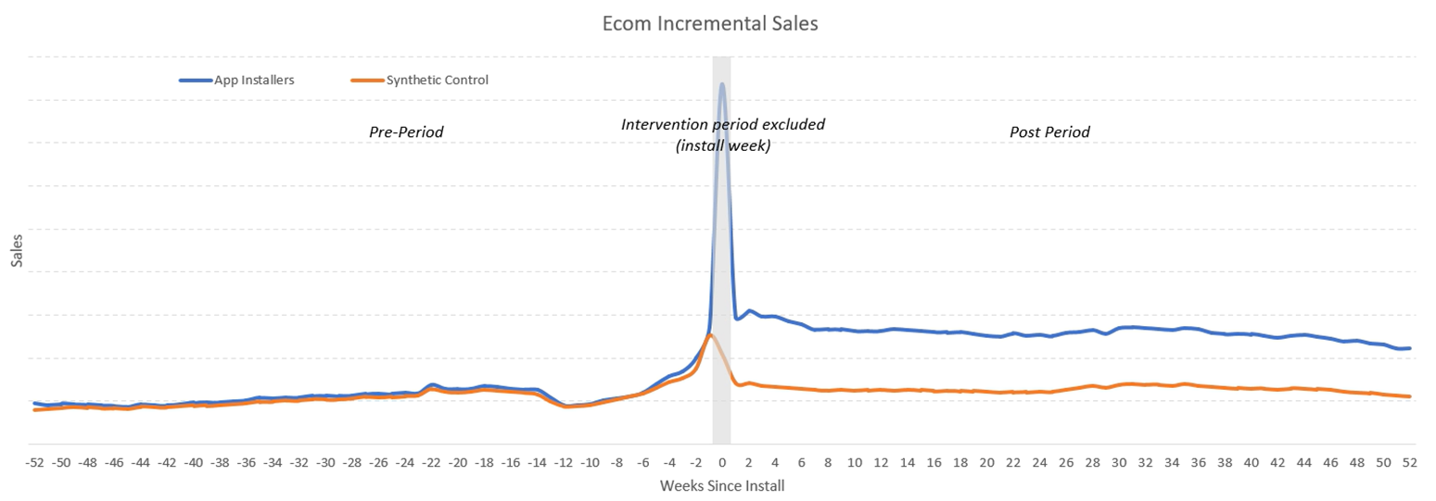
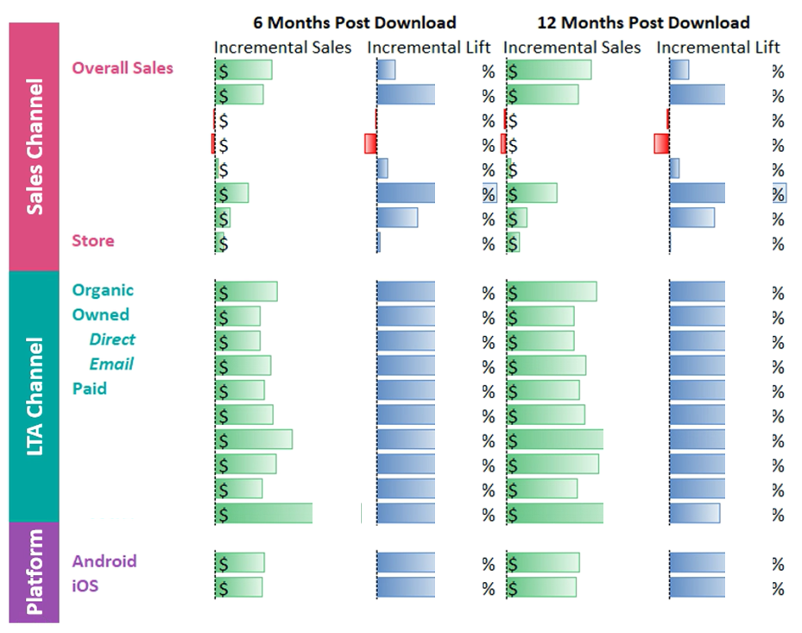
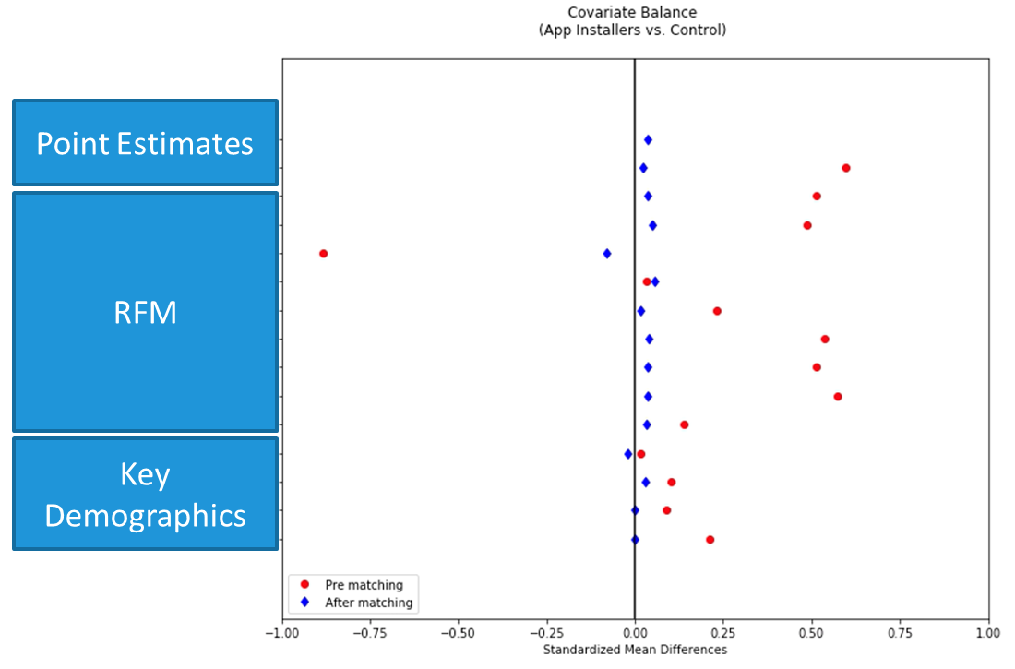
Impacts
Developed the analysis for xx MM downloads per year and estimated incremental revenue of $x.x Bn
Identified high value channels for App downloads to support future media strategy

